Slide 1
COMS30121 Image Processing and Computer Vision
Lecture 7 : Motion I - Modelling

Slide 2
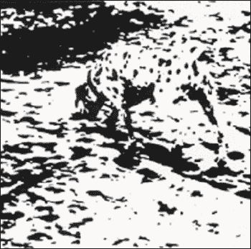

Slide 3
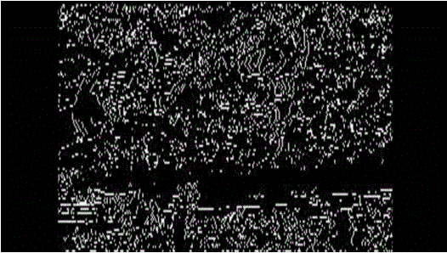


Slide 4
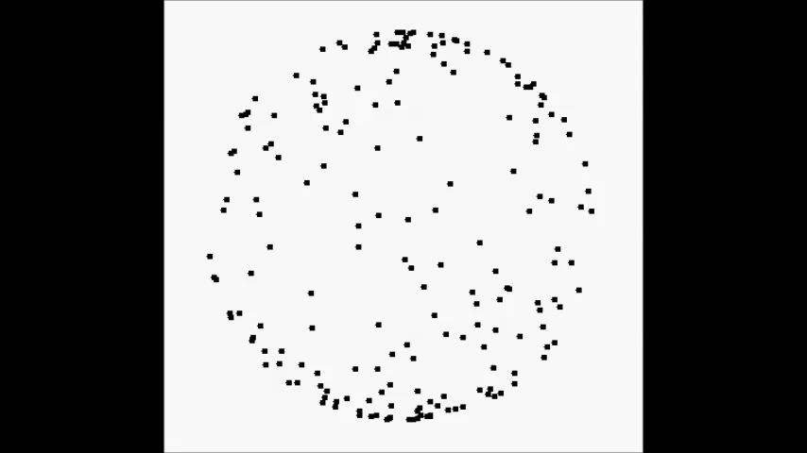

Slide 5
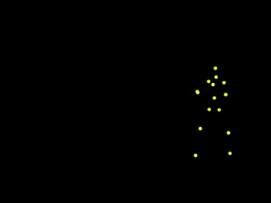

Slide 6
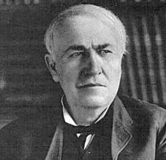
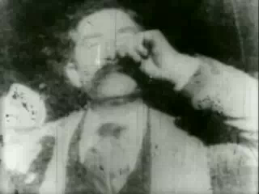
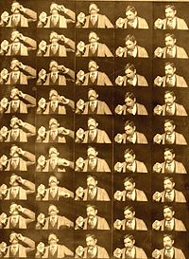
Video Sequences
Thomas Edison
Kinetograph
frames
time
y
t
Frame rate :
frames per second
e.g. 25 fps
x

Slide 7
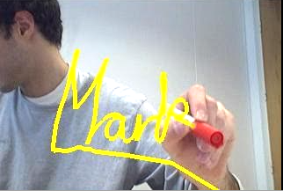
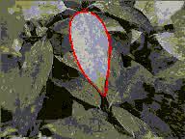

2-D Tracking

Slide 8
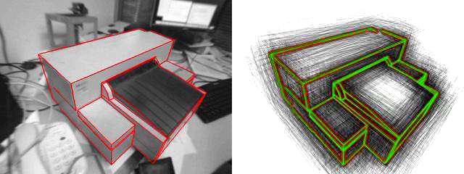
3-D Tracking – Model Based

Slide 9
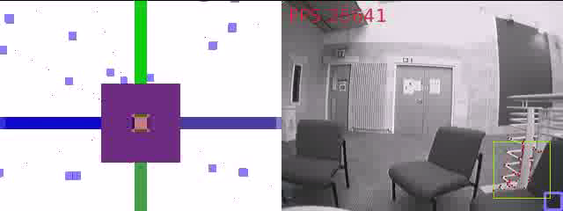
3-D Tracking and Mapping

Slide 10
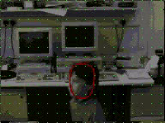
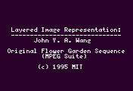
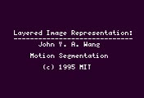
We are going to look at …..
Understanding 2-D motion fields
The optical flow equation (OFE)
Motion estimation
Lucas and Kanade method
Motion segmentation

Slide 11
Perspective Pin Hole Camera Model
camera
frame
image plane
focal
length
optical axis

Slide 12
Perspective Projection Equations
3D point: (on surface of object)
Projects to 2D point: (in image)
Then using similar triangles:

Slide 13
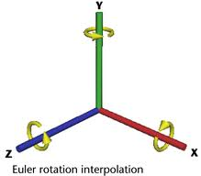
3-D Rigid Motion
: 3x3 rotation matrix
: 3x1 translation vector

Slide 14
Rotation Matrices
: Rotations about X, Y and Z axes
Z
NB : for small
X

Slide 15
3-D Motion Field
For small angles:
Hence:
Angular velocity
Rectilinear velocity

Slide 16
2-D Motion Field Equations
For image point
Quotient rule
Substituting for gives

Slide 17
Two Components
Translational – dependent on scene depth Z
Rotational – independent of scene depth Z

